Slide 1
Assembly

Slide 2
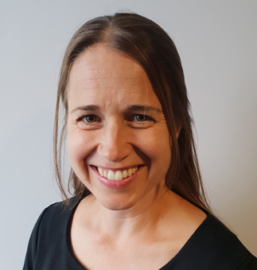
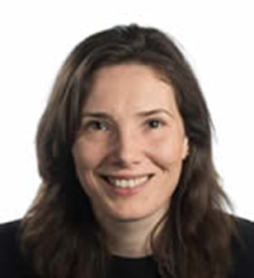
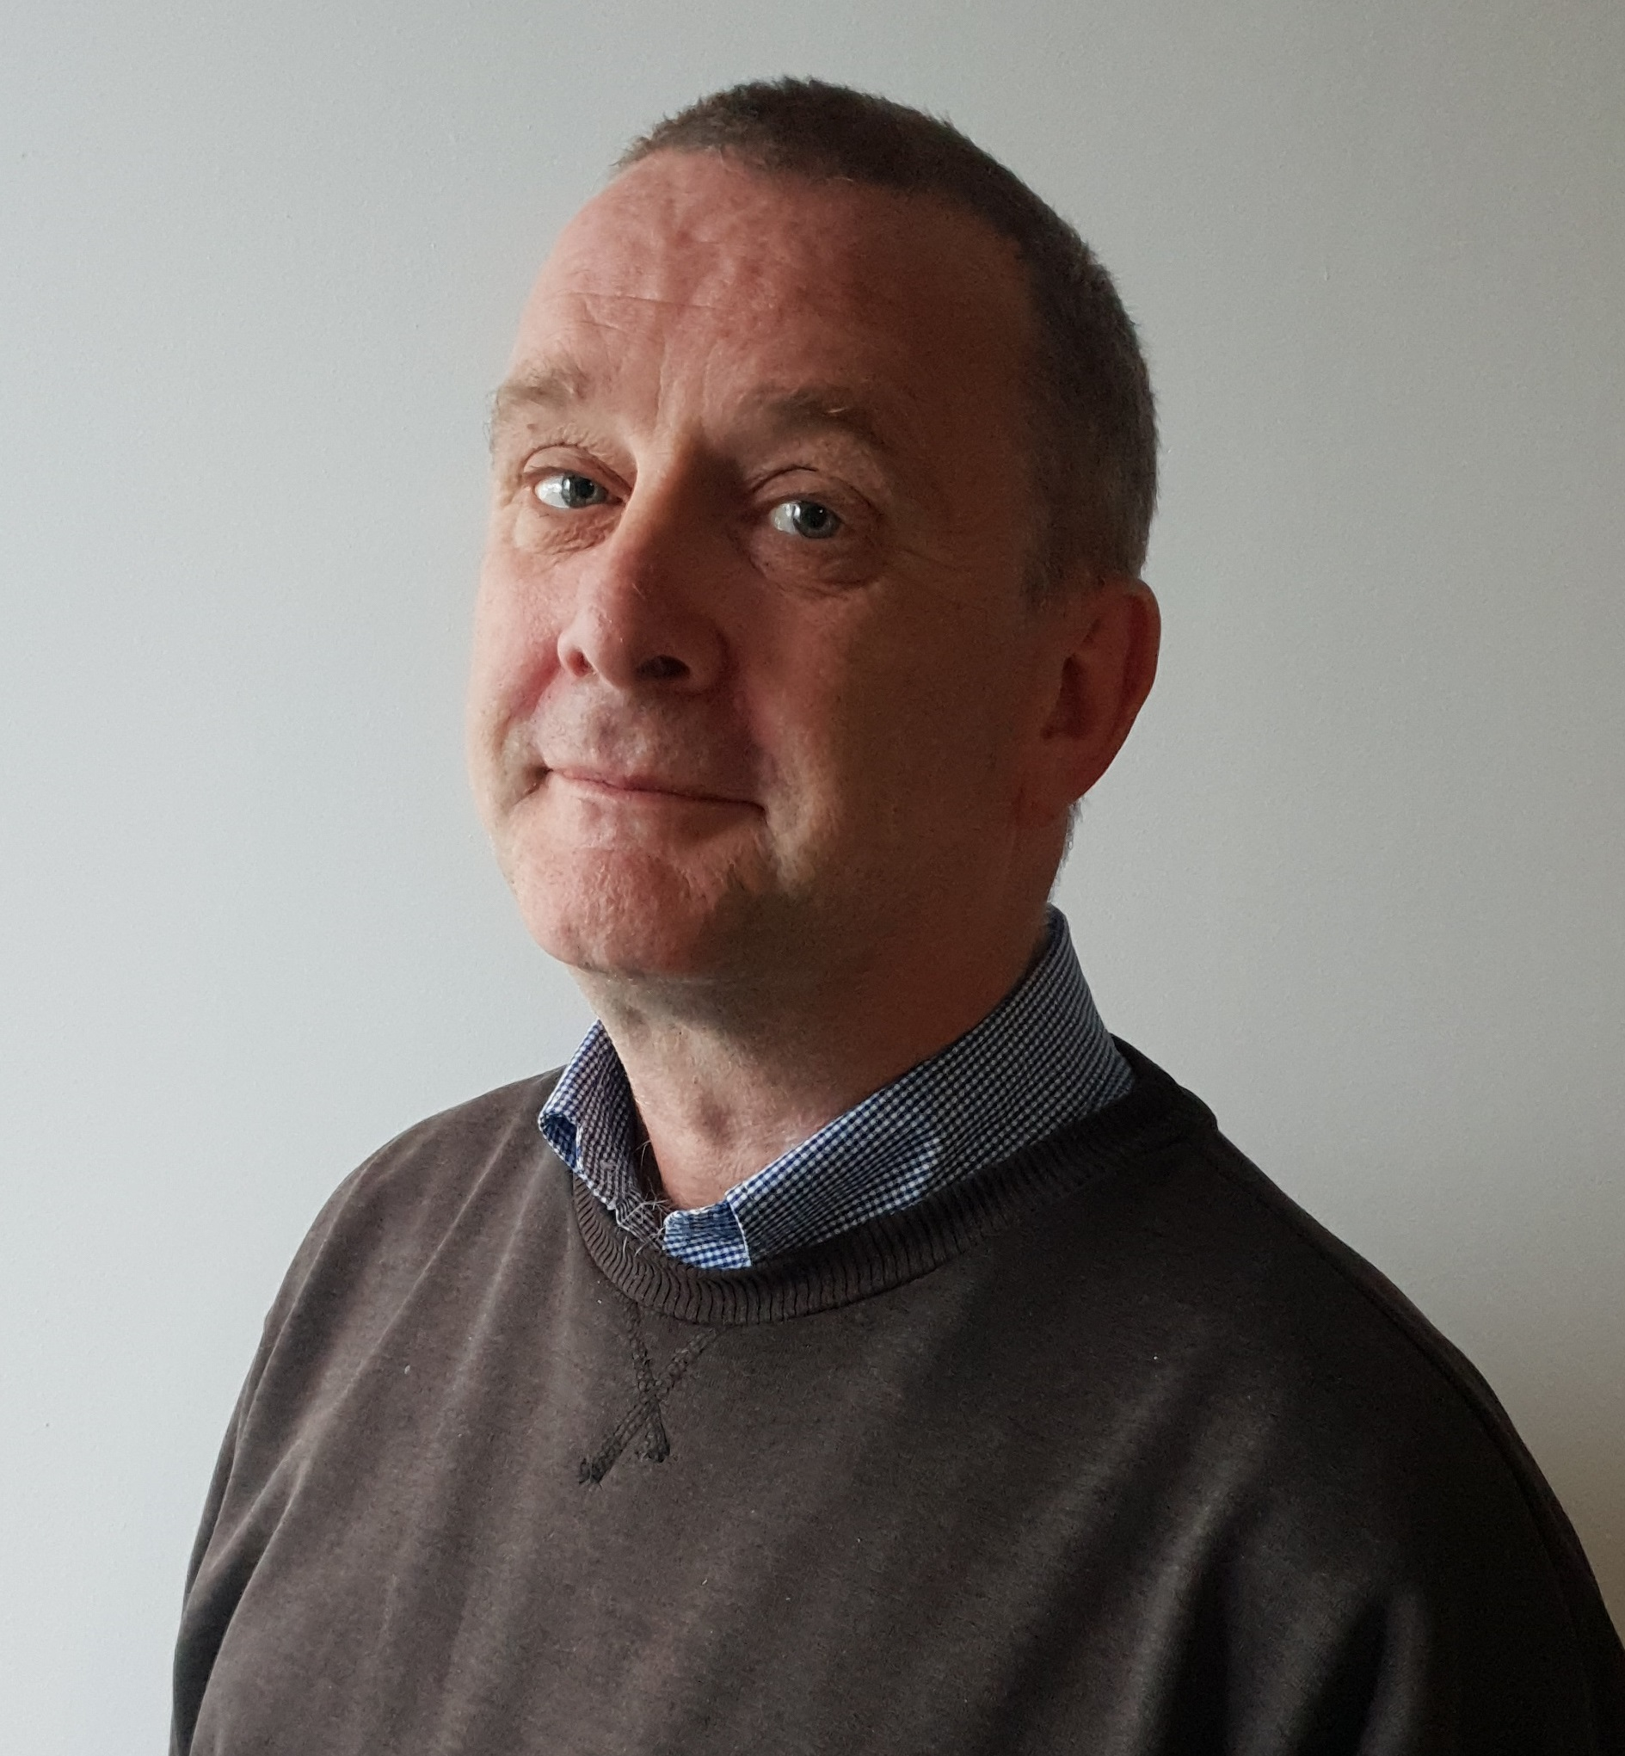
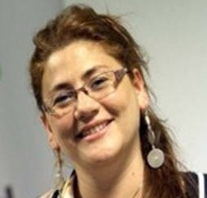
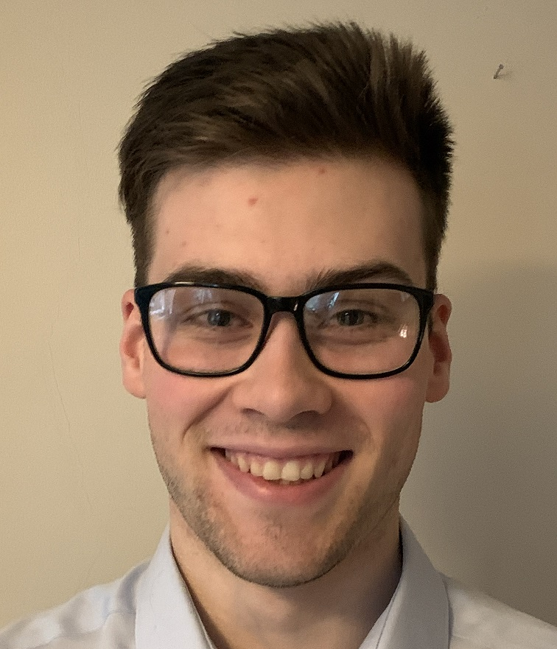
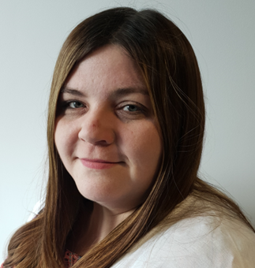
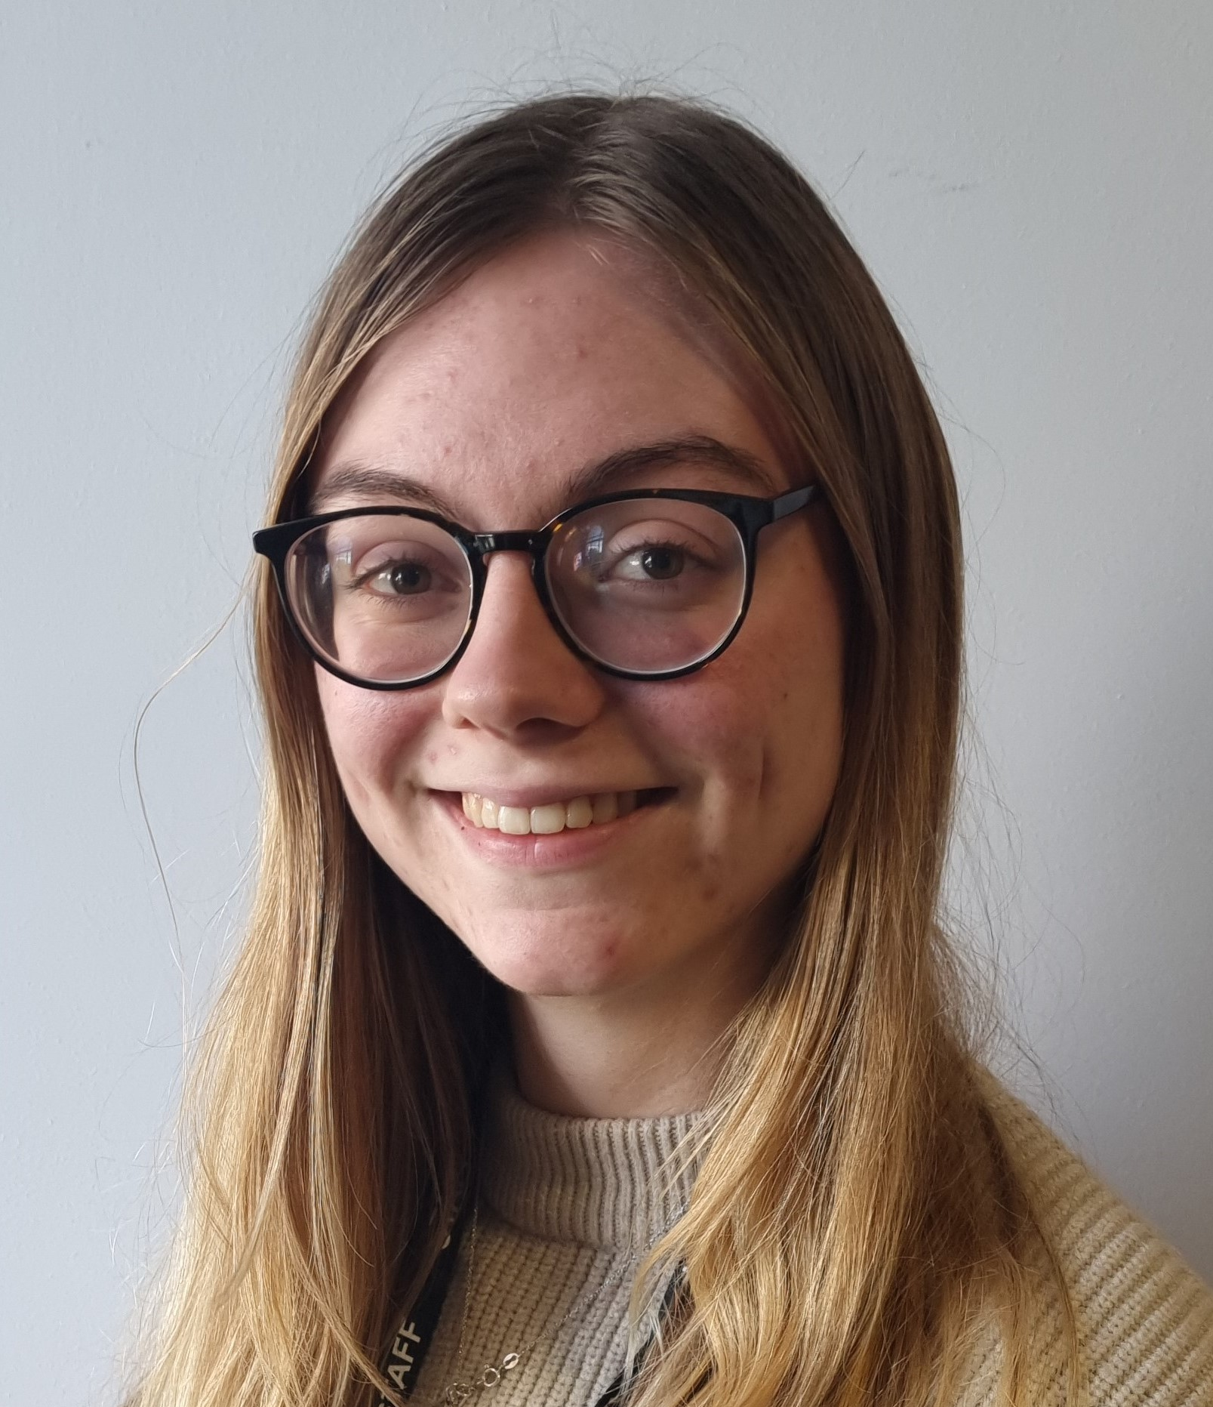
“Hello” from the Sunproofed team!
Research takes hard work from many people who work on the project together doing
different tasks like designing the project, getting information and looking at it!
Who are we?
What do we do on the
project?
Dr Julie Peconi
Dr Rachel Abbott
Prof. Alan Watkins
Dr Gisselle Tur Porres
Kirsty Lanyon
Jodie Millard
Daniel Tod
This project is happening at Swansea University with a team of researchers looking into sun safety in
primary school children. We get money from Welsh Government to do the project.

Slide 3
Assembly
Learn about behaviours that protect yourself and others from the sun.
Know the conditions where protection is needed.
Make your school as sun safe as possible.
Dispel myths about keeping safe in the sun.

Slide 4
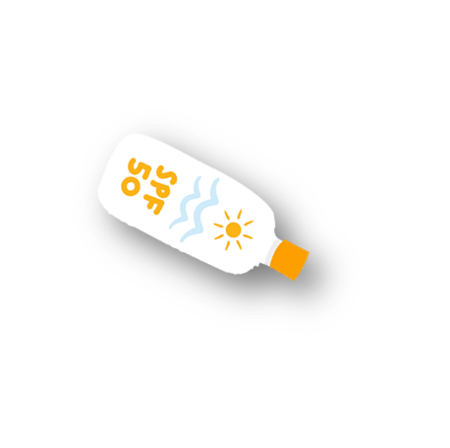
What happened at playtime?
What did you do?
Where did you play?
What did you wear?
How was the weather? How did you know?

Slide 5
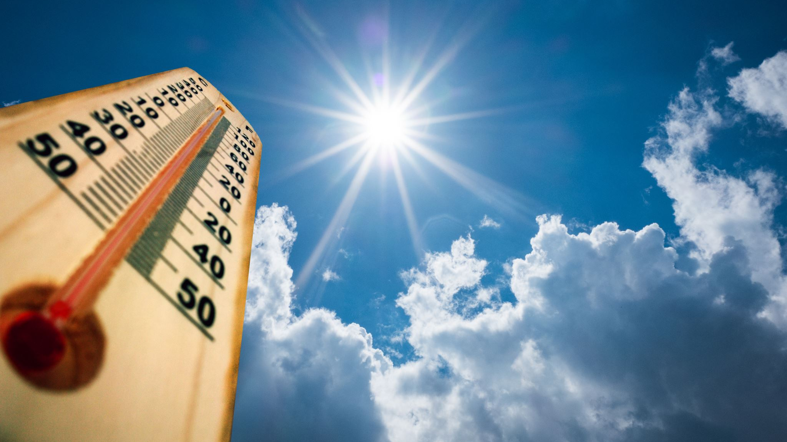
Feedback from Sun Squad

Slide 6
UV-rays experiment time!
UV waves are rays of light that come from the sun or from artificial devices like lamps or tanning beds.
Humans are not able to see UV lights with our eyes! Some insects and animals can!
How can we tell whether the sun may cause harm?
Notes:
9 Animals That Can Actually See in UV (interestingengineering.com)
Butterflies
Reindeer to spot lichens that they can eat, some rodents
Some birds
Bees
Sockeye salmon
Scorpions
Dogs and cats maybe able to see UV light
hedgehogs

Slide 7
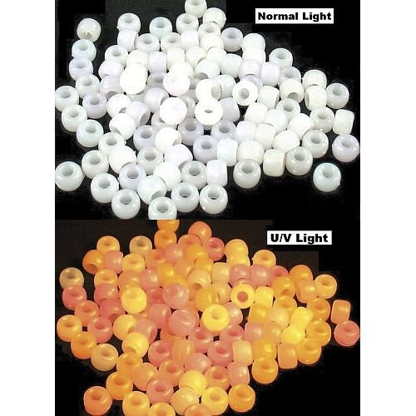
UV-rays experiment time!
Notes:
Feedback from sun squad – control vs experiment.
Children share what happened when they observed the beads.
We cant see UV light so it's always best to check the wethare forecast as the UV rating can be high even on cloudy days.

Slide 8
What do you check on the weather forecast?
Click the link for today.
Swansea - BBC Weather

Slide 10
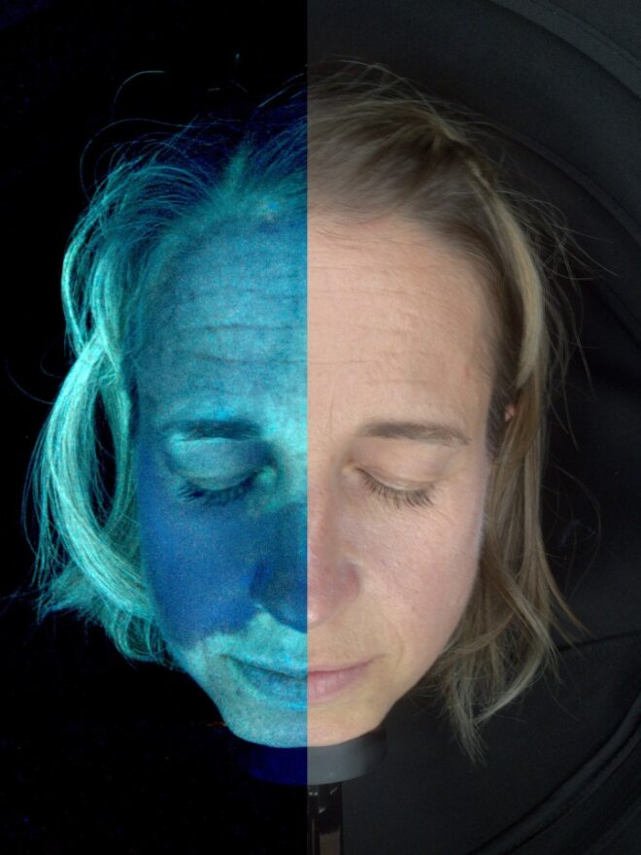
UV-rays experiment time!
Notes:
Children to feedback on the UV camera and explain what they saw.

Slide 11
UV-rays experiment time!

Slide 12
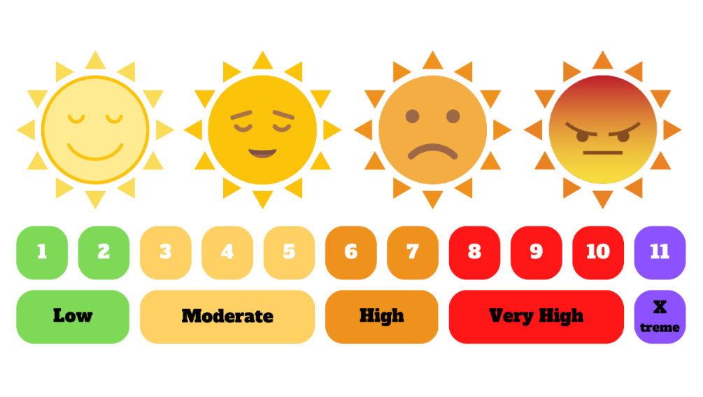
Myth Busting: UV-Rays can damage our skin and eyes even on a cool or cloudy day.
It is a good idea to start protecting your skin when UV is 3 or above

Slide 13
What are the best ways you can think of to protect your skin?
Notes:
Take ideas from children.
Resources to have ready:
T-shirt
Suncream
Hat
Sunglasses
UV umbrella – for shade

Slide 14
How do you protect yourself? What are the 5 s's on sun safety?
S
S
S
S
S

Slide 15
How do you protect yourself? What are the 5 s's on sun safety?
Slip on a T-shirt
Slop on some factor 30+suncream
Slap on a hat
Slide on some sunglasses
Shade from the sun when possible
Look at selection of hats and tops and decide which is best to keep safe in the sun.
Notes:
This can be a fun dressing up session if we can find the resources.
Ask for volunteers.
Which hat is best? - have a selection to try such as caps and wide-brimmed hats.
Which top is best? - T-shirt / strappy top

Slide 17
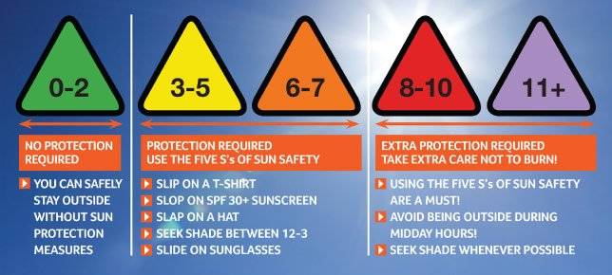
What can your school do to protect you on high UV days?
Notes:
Stress importance of avoiding the sun when UV rating is high.
Limit time outside / during PE
Make sure clothing is appropriate – shoulders covered / wide-brimmed hat
Ensure suncream has been applied before playtimes
Have indoor activities at lunchtime
Invest in playground shade

Slide 18
True or False? I can get burned on cloudy days.

Slide 19
True or false? The sun is strongest in the middle of the day.
Fun fact! If your shadow is taller than you are, your UV exposure is likely to be lower. But... if your shadow is shorter than you are, your UV exposure is high.
Notes:
UV light is strongest between 10am and 4pm – most of the time you are at school!

Slide 20
True or False? Suncream with a high number will protect my skin better.

Slide 21
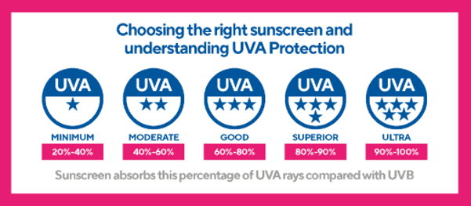
When choosing sunscreen, look for a high SPF (sun protection factor) and a good star rating to protect against both UVB and UVA rays! 😎🌞
Notes:
Star rating measure UVA radiation

Slide 22
True or False? Applying sunscreen is easy. Don’t forget your back, scalp, ears, lips, eyelids, ears, feet and hands!

Slide 23
True or False? Too much sunlight can damage my skin.

Slide 24
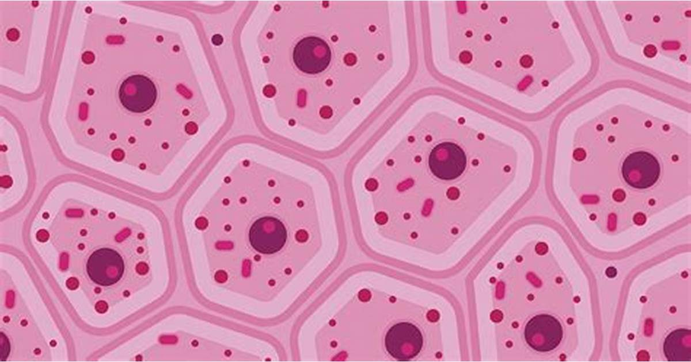
True or false? If I get sunburnt as a child, it won't matter when I am older.
Notes:
Discussion about skin cells and possible changes to cells in later life.

Slide 25
True or false? The best way to protect your skin is to wear suncream.
Notes:
False – it's the last defense against the sun.
Remember there are 5 s's.

Slide 26
Based on what you have learned today, let’s vote on the following statements:
Notes:
False – it's the last defense against the sun.
Remember there are 5 s's.

Slide 27
I will play in the shade at school.

Slide 28
I will bring a hat to school.

Slide 29
I will apply sunscreen on sunny days and cloudy days when the UV rating is above 3 or above.

Slide 30
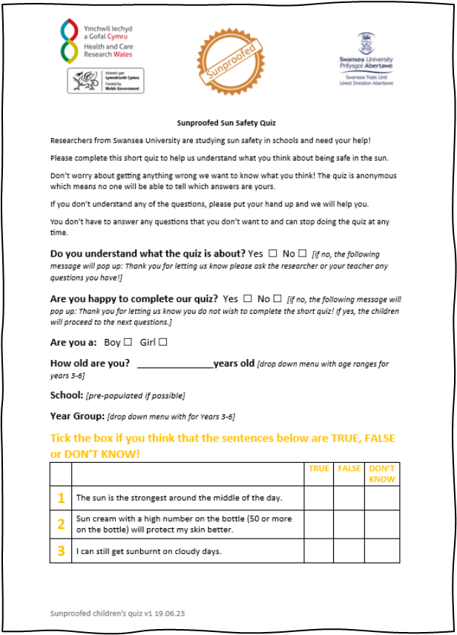
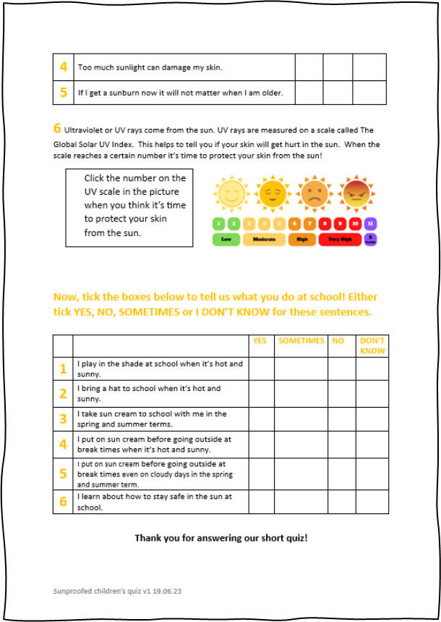
What we did…
THE QUIZ
By now you will have all completed our quiz!
We wanted to know how well you understand about keeping yourself safe in the sun.
We'll put your answers together in an online database.
Fun fact! A database is something used in
research to see all the data in one
place on a computer and to store it
safely to look at later.
Page 1
Page 2

